Slide 1



Coffee Shop
Group 6

Slide 2



MEMBERS
-Lâm Tấn Phát
-Lê Hữu Khoa
-Nguyễn Trọng Quý
-Nguyễn Thanh Bảo

Slide 3
Table of content
Purpose
Database
Front-end
Back-end

Slide 4
Purpose
This project aims to create a comprehensive management system for a coffee shop, including functionalities for the admin (owner), staff, and customers. The system will be built using Java Tomcat, Servlets, MySQL, HTML, CSS, and JavaScript.

Slide 5
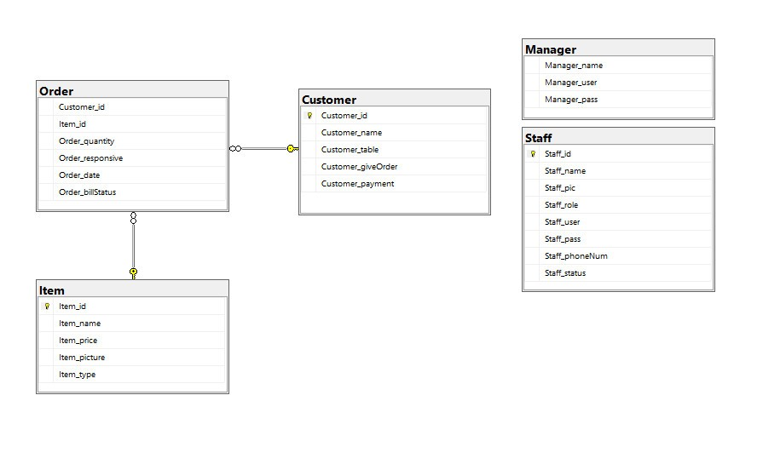
Database

Slide 6
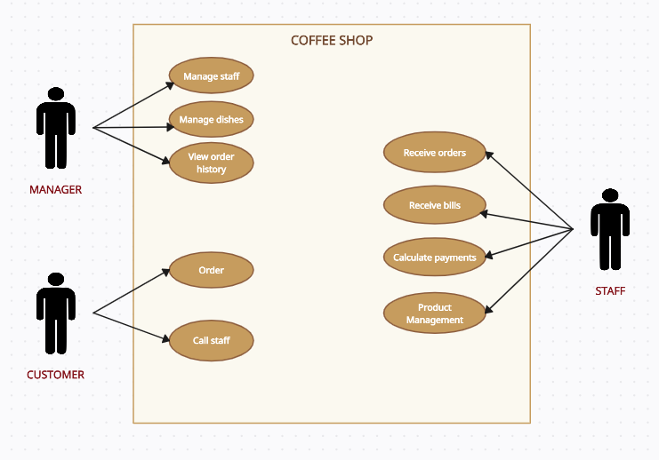
Uses Case

Slide 7
Front-end

Slide 8
Customer Page

Slide 9
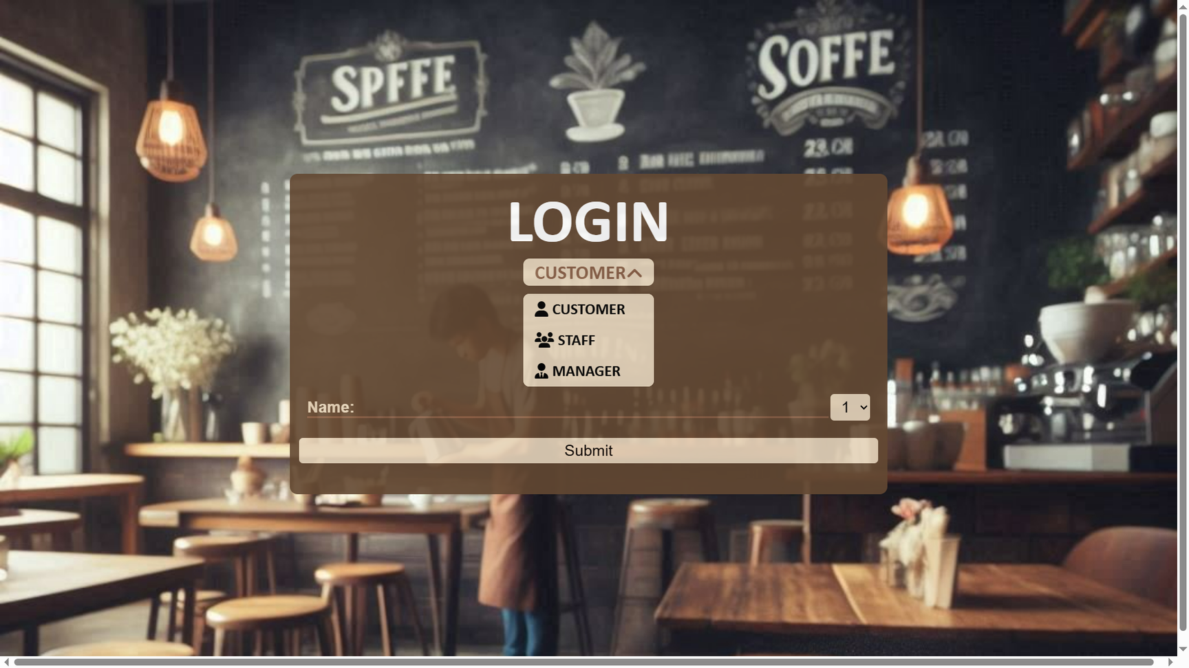
Logins
Includes: Customer, Staff and Manager

Slide 10
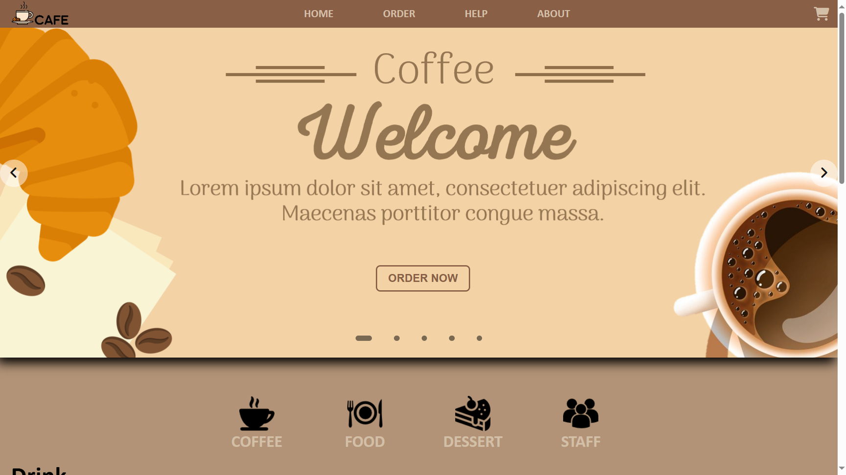
Customer Homepage

Slide 11
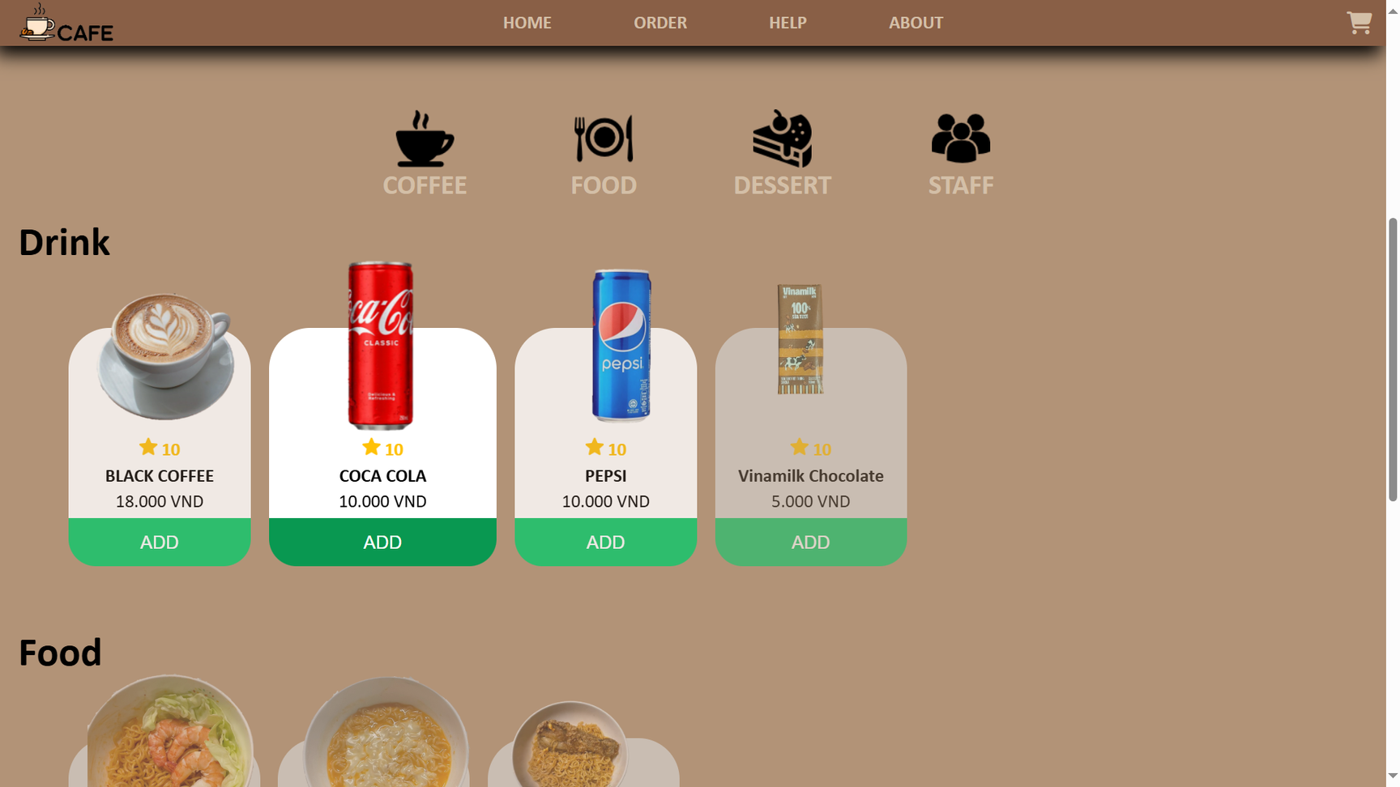
Customer ordering section includes: Drinks and Foods

Slide 12
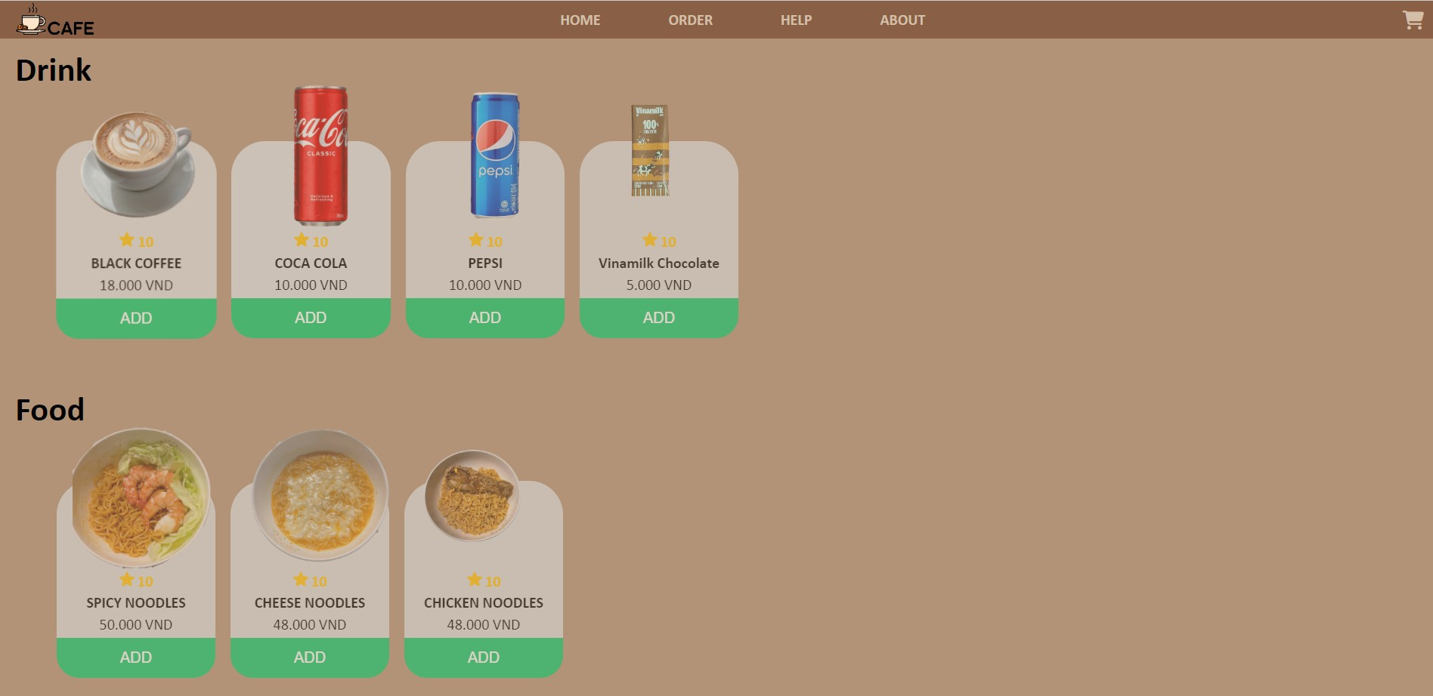
Customer ordering section includes:
Drinks and Foods

Slide 13
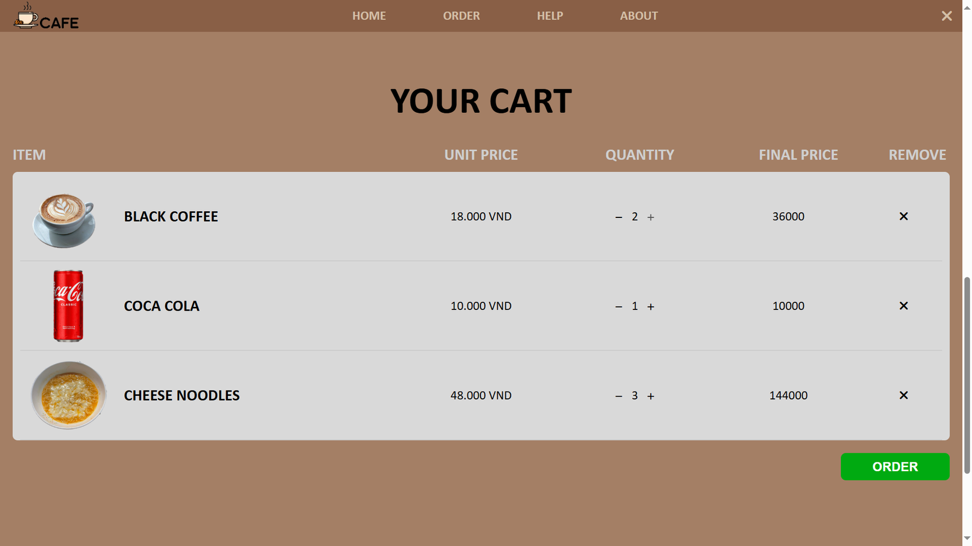
Customer Cart

Slide 14
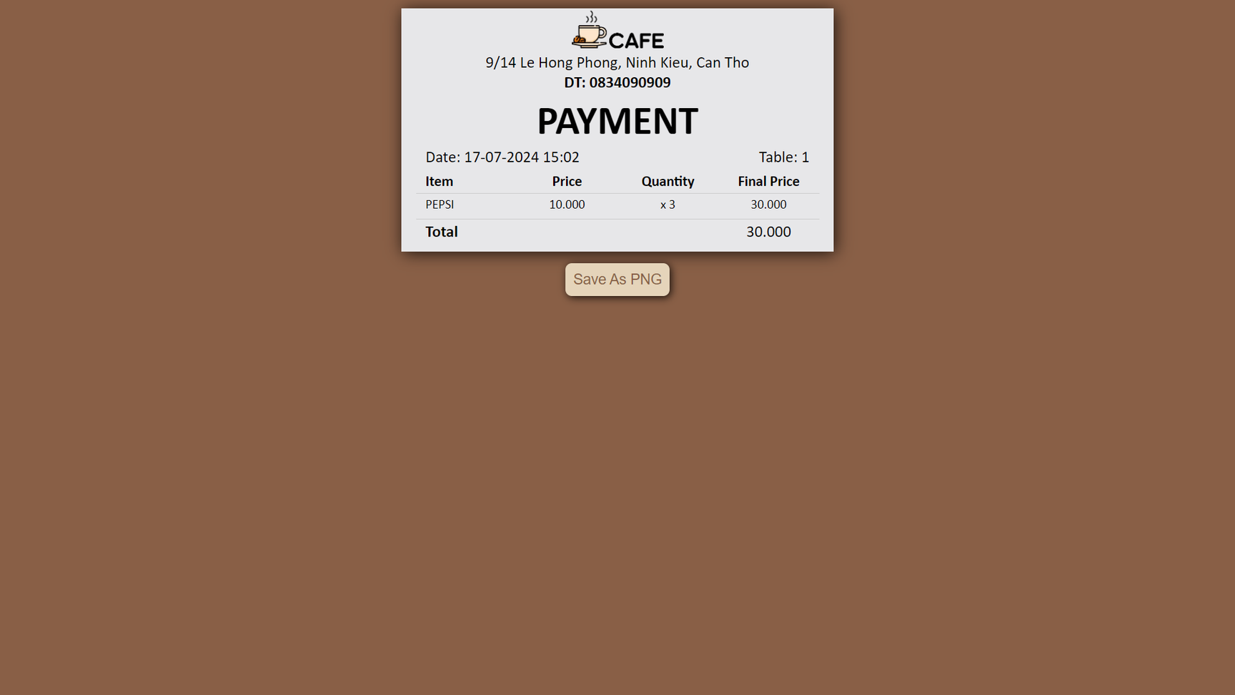
Customer Order bill

Slide 15
Staff

Slide 16
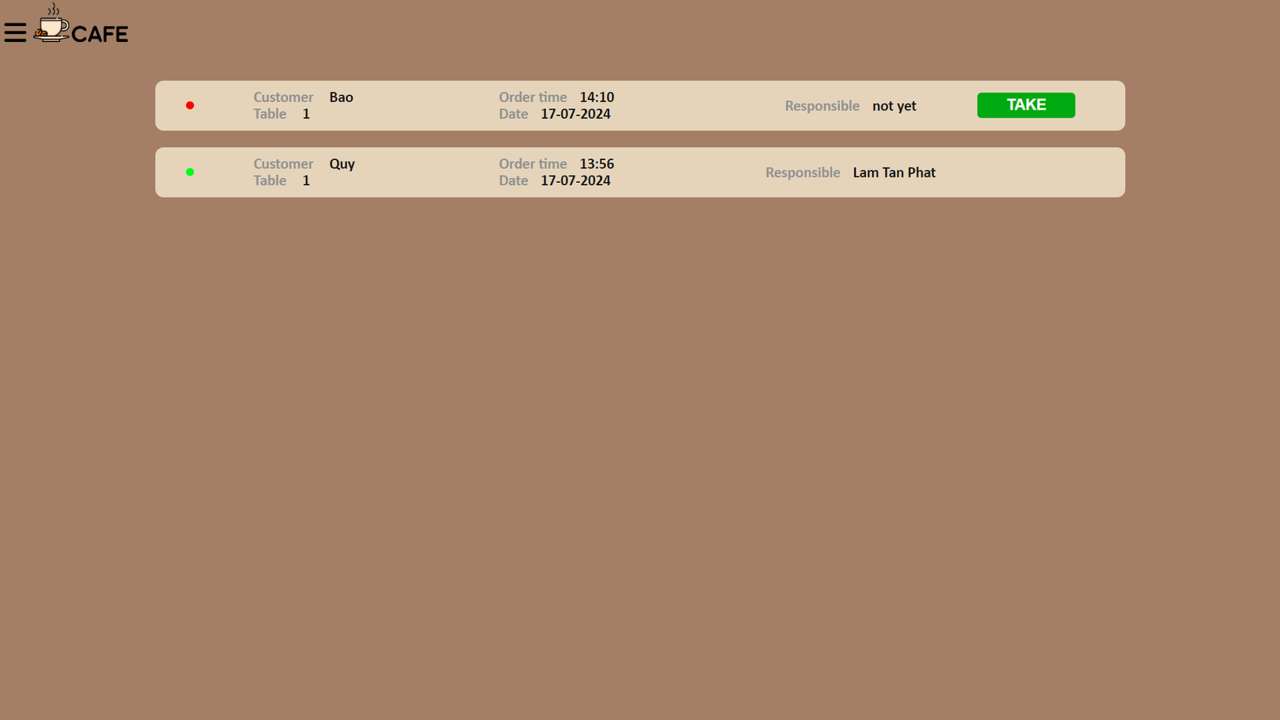
Staff Order page

Slide 17
Admin

Slide 18
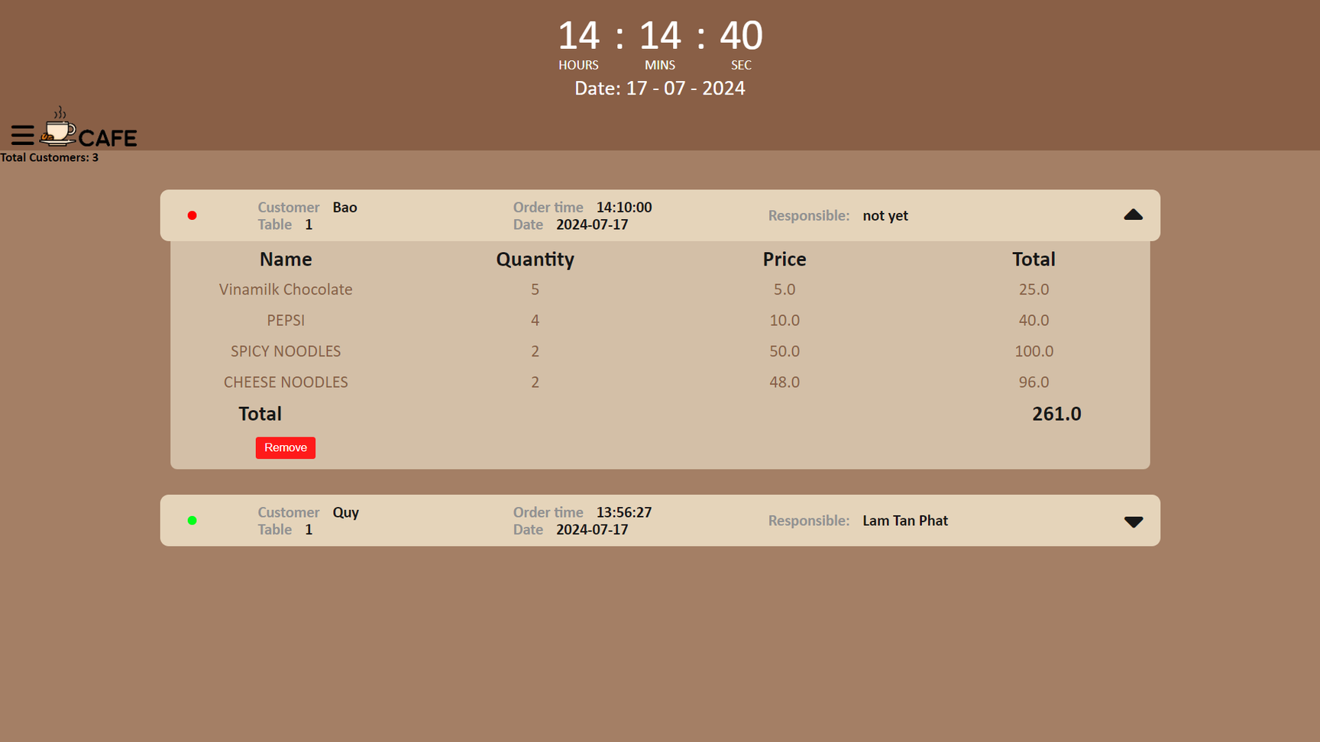
Admin Order page

Slide 19
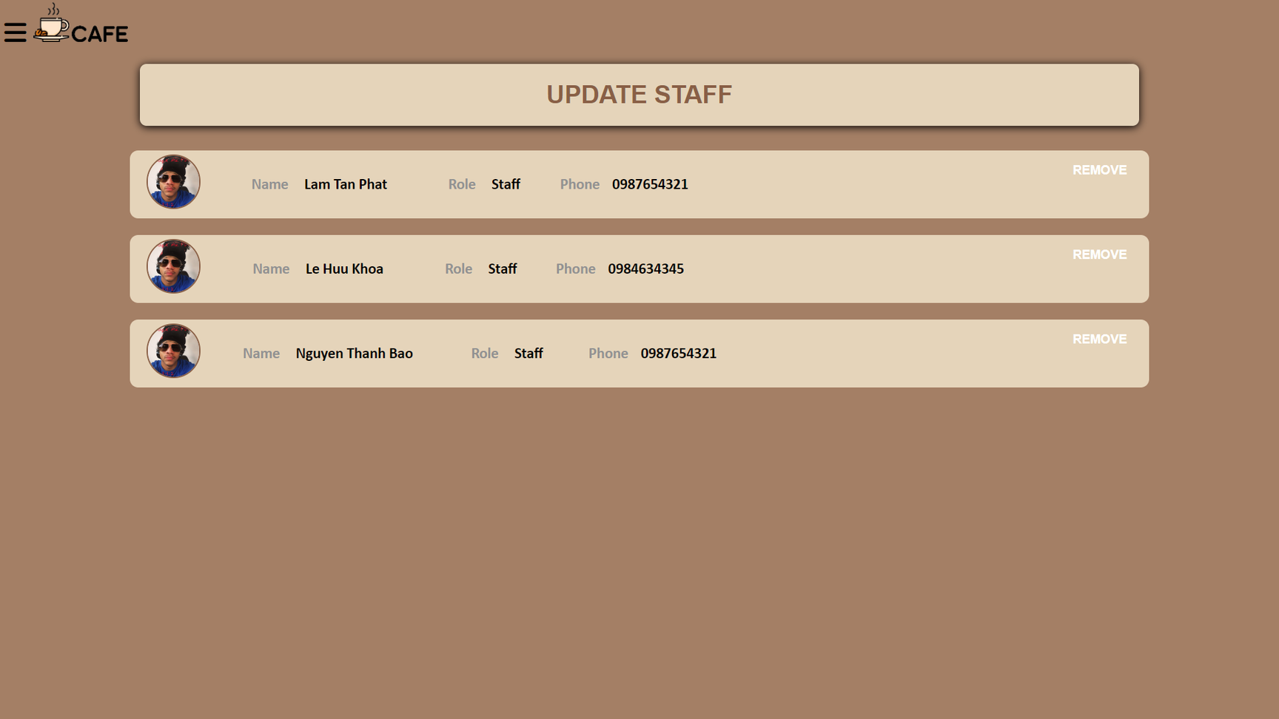
Admin Staff page

Slide 20
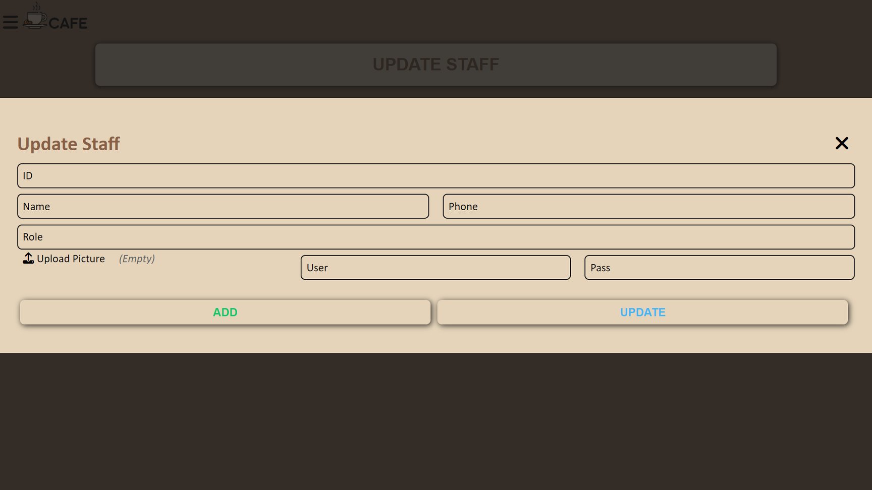
Admin Update Staff

Slide 21
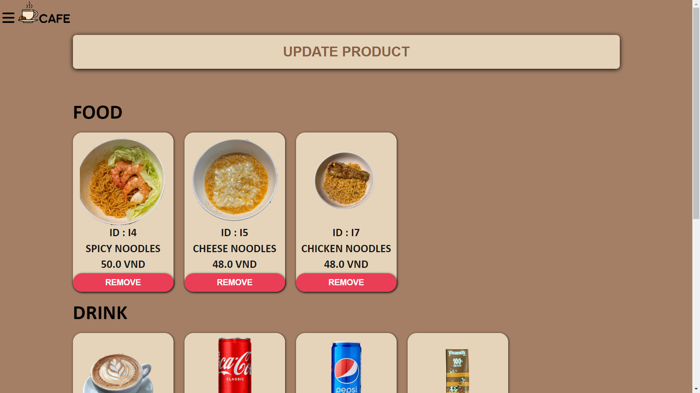
Admin Product page

Slide 22
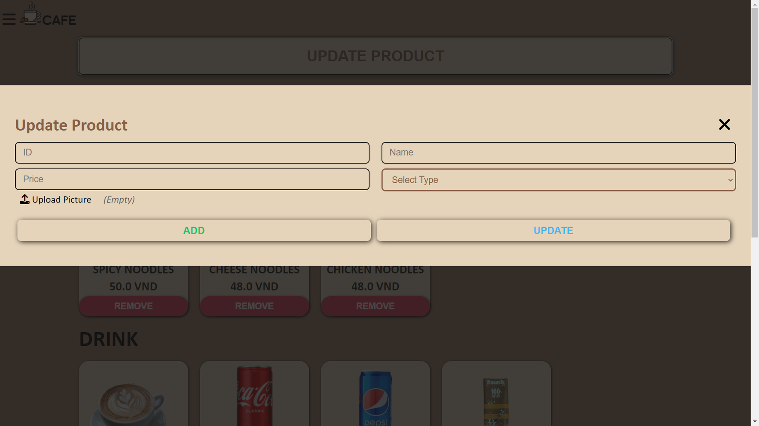
Admin Update Product

Slide 23
Demo

Slide 24

Thank You
For Listening

